Slide 1
You can listen to the English version of this course at Multi-purpose Classroom Building R202.
本教室禁止飲食、在無法保持社交距離的情況下請戴口罩

Slide 2

Machine Learning (ML) 2021
李宏毅
Hung-yi Lee

Slide 3
About this course
You can complete this course online.
Record all the lectures, submit homework online, no exam.
No prerequisite test, no upper limit for the number of students.
Everyone can take this course!
國立台灣大學教務處
Special thanks to
National Taiwan University
Office of Academic Affairs
Notes:
感謝教務處支持TA的經費
介紹這門課你適不適合修這門課呢?

Slide 4
About this course
This course has both Mandarin and English versions.
Time slot: 2:20 p.m. – 6:20 p.m., Friday
How to achieve that?
Notes:
本課程開放非同步英文班
Classroom:
Mandarin version: 綜合大講堂
English version: ROOM_NUM

Slide 5


Help of Technology!
Speech Recognition
Mandarin
Text (Chinese)
Expert
Machine Translation
Text-to-Speech
Synthesis
English
Text (English)
TA
Correct
The lectures of the English course will be one week behind the Mandarin one.
The homework announcement and deadline of the English and Mandarin courses are the same.
Notes:
Translate the lecture recording in Mandarin into English

Slide 6
Orientation
Focus on deep learning
This course can be your first ML course.
Little overlap with Hsuan-Tien Lin’s (林軒田) Machine Learning Foundations and Machine Learning Techniques.
Include the latest technologies
Computer Vision
Hsuan-Tien’s
ML
This course
Human Language
Finance
your first ML course
……

Slide 7
Orientation
It’s buffet style.

Slide 8
Assignment

Slide 9
Prerequisite
Math: Calculus (微積分), Linear algebra (線性代數) and Probability (機率)
Programming
All the assignments have sample codes based on Python.
You need to be able to read and modify the sample codes. This course will not teach Python.
This course will not teach any Python package, except PyTorch.
Only focus on ML. TAs do not have to answer the questions not related to ML or PyTorch.
Hardware: All assignments can be done by Google Colab. You do not need to prepare hardware or install anything.
Notes:
We don’t really need data structure or algorithm, although they are important.
You may still get C- if you cannot program.
電機系 有運算資源

Slide 10
Assignment
Each assignment includes multiple-choice questions and/or leaderboard (排行榜).
Multiple-choice questions: submitted via NTU COOL.
Leaderboard: Kaggle or JudgeBoi (our in-house Kaggle ☺ )
Explain later
You also need to submit the related codes of each assignment via NTU COOL.
Notes:
What if I submit a empty file?

Slide 11
Grading Criterion
There are 15 assignments (each has 10 points, only count the 10 assignments with the highest points)
You don’t need to do all the assignments. Choose the ones you are interested in.
You are encouraged to complete all 15 assignments!
You decide how much you want to learn.

Slide 12
Assignment Schedule
 |  | Start | End | Kaggle | JudgeBoi | MC
1 | Regression | 3/05 | 3/26 | O
2 | Classification | 3/12 | 4/02 | O |  | O
3 | CNN | 3/26 | 4/16 | O
4 | Self-attention | 3/26 | 4/16 | O
5 | Transformer | 4/09 | 4/30 |  | O
6 | GAN | 4/16 | 5/14 |  | O
7 | BERT | 4/30 | 5/21 | O
8 | Autoencoder | 4/30 | 5/21 | O
9 | Explainable AI | 5/07 | 5/28 |  |  | O
10 | Attack | 5/07 | 5/28 |  | O
11 | Adaptation | 5/21 | 6/11 | O
12 | RL | 6/04 | 6/25 |  | O
13 | Compression | 6/11 | 7/02 | O
14 | Life-long | 6/11 | 7/02 |  |  | O
15 | Meta Learning | 6/18 | 7/09 |  |  | O

Slide 13
Grading Criterion
C-
The assignments have sample codes.
Simply running all the sample codes leads to C-.
A-
There is guidance for each homework
Write your codes following the guidance.
A+
We set some challenges for you.
Conquer by yourself (think, read papers, etc.)
這不是一門甜涼的通識課
You decide how deep you want to learn.
Notes:
很多人都需要學機器學習
但這門課是否真的適合你
我一直說這門課很簡單
但也有人告訴我很難

Slide 14
Lecture Schedule

Slide 15
Lectures
Date | Topic | HW
2/26 | Introduction
3/05 | Deep Learning | Regression
3/12 | Self-attention | Classification
3/19 | Theory of ML (Prof. Pei-Yuan Wu)
3/26 | Transformer | CNN / Self-attention
4/02 | Spring break (No class)
4/09 | Generative Model | Transformer
4/16 | Self-supervised | GAN
4/23 | Midterm (No class)
4/30 | Explainable AI / Adversarial Attack | BERT / Autoencoder
5/07 | Domain Adaptation / RL | Explainable AI / Attack
5/14 | Privacy v.s. ML (Prof. Pei-Yuan Wu)
5/21 | RL | Adaptation
5/28 | Quantum ML (Prof. Hao-Chung Cheng)
6/04 | Life-long / Compression | RL
6/11 | Meta Learning | Life-long / Compression
6/18 |  | Meta Learning

Slide 16
Lecture Schedule
Assignment announcement: 2:20 p.m. – 3:30 p.m. (approx.)
Lectures: 3:30 p.m. - 6:20 p.m.
Highly related to the assignment next week
We will usually finish the lectures before 6:20 p.m.
The rest is TA hour.
Assignment announcement and lectures will be recorded.
This course can completely learn online.

Slide 17
Lectures
Date | Topic | HW
2/26 | Introduction
3/05 | Deep Learning | Regression
3/12 | Self-attention | Classification
3/19 | Theory of ML (Prof. Pei-Yuan Wu)
3/26 | Transformer | CNN / Self-attention
4/02 | Spring break (No class)
4/09 | Generative Model | Transformer
4/16 | Self-supervised | GAN
4/23 | Midterm (No class)
4/30 | Explainable AI / Adversarial Attack | BERT / Autoencoder
5/07 | Domain Adaptation / RL | Explainable AI / Attack
5/14 | Privacy v.s. ML (Prof. Pei-Yuan Wu)
5/21 | RL | Adaptation
5/28 | Quantum ML (Prof. Hao-Chung Cheng)
6/04 | Life-long / Compression | RL
6/11 | Meta Learning | Life-long / Compression
6/18 |  | Meta Learning

Slide 18
Kaggle

Slide 19
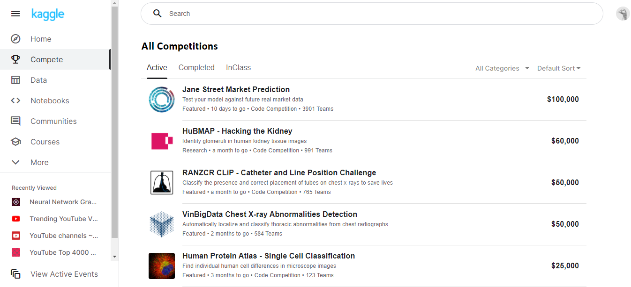
Kaggle (JudgeBoi is similar)
https://www.kaggle.com/
Some assignments are in-class competition on Kaggle.
Register a Kaggle account by yourself.
Notes:
Kaggle 是一個龐大的資料科學社群，上面有各種資料分析的競賽。本 學期的部份作業也會使用到 Kaggle 上的 in-class competition。

Slide 20
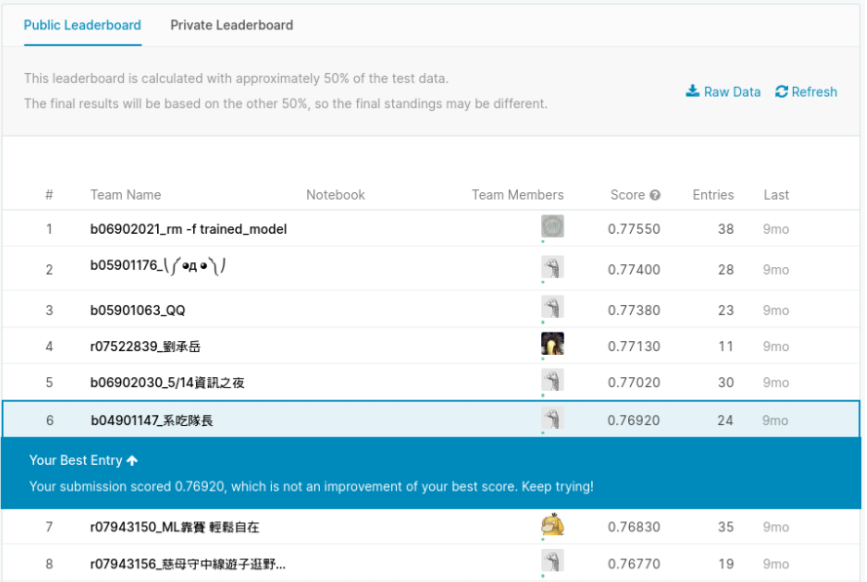
display name
score

Slide 21
Kaggle
The display name should be
Example
<STUDENT ID>_<ANY THING>
b93901106
truly any thing ☺
b93901106_pui pui pui pui pui pui pui pui
b93901106_
b93901106 puipui
We will not find your submission if your format is wrong!

Slide 22
Public score: You can see it right after the submission.
Private score: You can only see the score after the assignment deadline.
Why?
display name
score

Slide 23
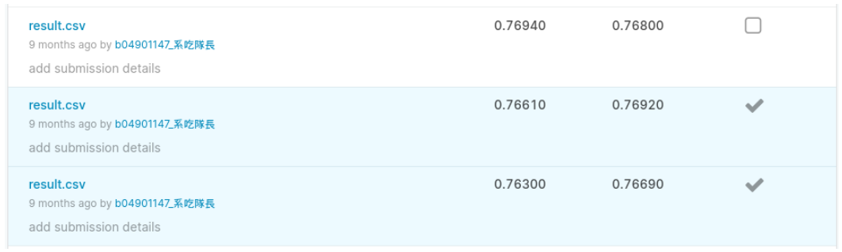
Kaggle
You need to select two results for evaluating on the private set before the assignment deadline.
You only have limited submission times per day.
Why?

Slide 24

Rules

Slide 25
Rules – Common Sense
Don’t plagiarize other’s code and don’t submit other’s results to the leaderboards.
“Other” means all creatures in the universe
Changing the names of variables also considered plagiarism. (Plagiarism is checked by the software!)
Protect your efforts! Don’t let others see your codes, don’t give others your results.
Lending your codes to others or allowing others to copy your work will be considered as collusion, thus receiving the same punishment as the plagiarist.
Notes:
Lending your codes to others or allowing others to copy your work will be considered as collusion and thus receiving the same punishment as the plagiarist.

Slide 26
Rules – For Kaggle and JudgeBoi
There is a limited number of submissions to all the leaderboards (Kaggle and JudgeBoi).
Don’t try to have multiple accounts. (It also violates the rules of Kaggle.)
Don’t borrow account from others and don’t give you account to others.
Don’t submit to the leaderboards of the previous semesters.
Don’t use any approach to increase the submission numbers
Notes:
請不要抄襲同學的作業和程式碼、 也不會把程式碼和結果借給其他同學看
我們無法分辨無法分辨抄襲和被抄襲，兩份作業都視同抄襲
同學包含這學期和過去修過課的同學
每一個作業都有規定 (不能用)
上述問題，第一次抓到當次作業 0 分，第二次犯就直接當掉 (決不寬容)
其他上述沒有規定的事項，由老師和助教按照公序良俗與公平性來處理 上述問題，第一次抓到當次作業 0 分，第二次犯就直接當掉 (決不寬容)
其他上述沒有規定的事項，由老師和助教按照公序良俗與公平性來處理

Slide 27
Rules – For Kaggle and JudgeBoi
The results submitting to the leaderboards should only come from machines.
Don’t label the testing data by humans (or any other approaches)!
The data used in assignments is publicly available. Don’t use the labels of testing data in any way!
Tip:
Don’t try to find the data used in assignments online at the very beginning.
Only use the data provided in each assignment.
Notes:
Lending your codes to others or allowing others to copy your work will be considered as collusion and thus receiving the same punishment as the plagiarist.

Slide 28
Rules - Codes
You need to submit codes for each assignment via NTU COOL.
Your codes need to be able to generate the results you submit to the leaderboard.
If not, it would be considered cheating and get punishment.
TAs may not run all the codes, but TAs will check some of them.
If you get 10 points in the assignment, your code will be open to the whole class (作業觀摩).
TAs and the lecturer decide cheating or not.

Slide 29
Punishment
The first time you violate the rules.
The final score of this semester times 0.9.
The second time you violate the rules.
Fail the course.

Slide 30

Information

Slide 31
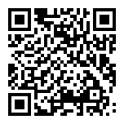
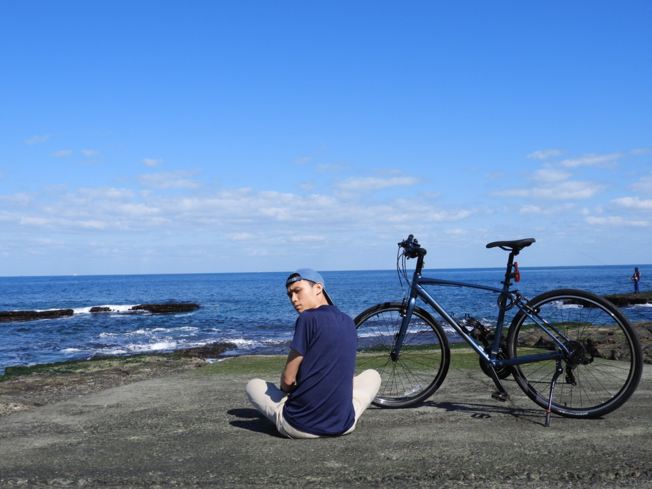
Webpage
You can find slides and lecture recordings here.
姜成翰
https://speech.ee.ntu.edu.tw/~hylee/ml/2021-spring.html
who made this webpage
Notes:
https://speech.ee.ntu.edu.tw/~hylee/ml/2021-spring.html

Slide 32
Questions
Option 1: Ask at TA hour
Option 2: Post your questions on NTU COOL
Your questions are also other’s questions.
Option 3: Mail to the following address
E-mail: ntu-ml-2021spring-ta@googlegroups.com
E-mail title includes “[hwX]” (e.g. [hw3])
Don’t direct message to TAs. The TAs will only answer the questions by the above alternatives.
Notes:
Option 2 is recommended.

Slide 33
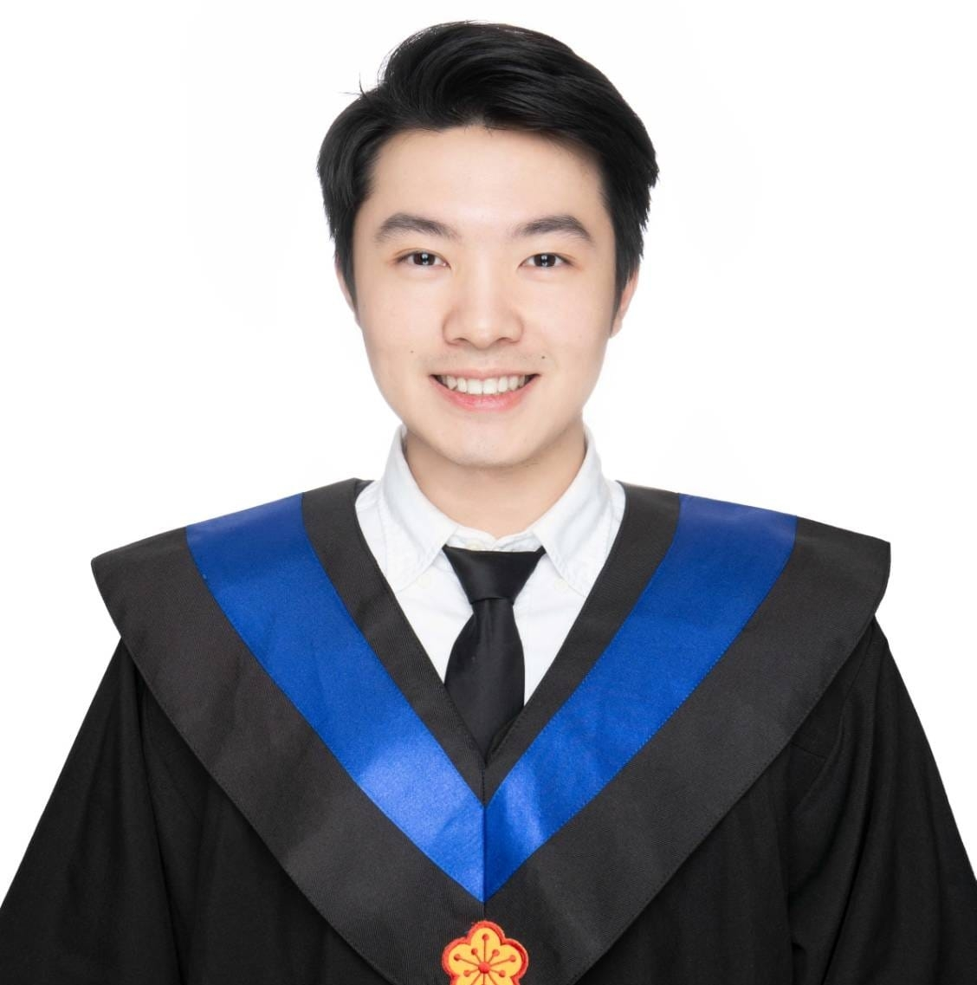
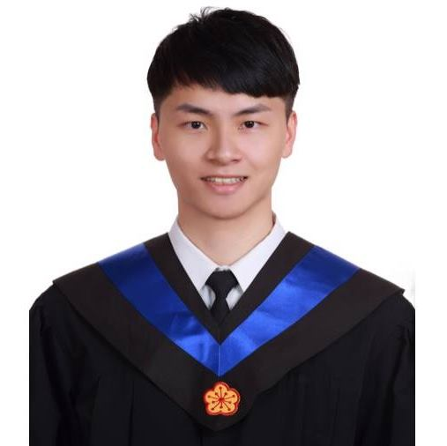
張凱為
黃冠博
Mandarin Course TA head
English Course
TA head
TA email: ntu-ml-2021spring-ta@googlegroups.com

